Slide 1
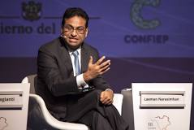
FBI
development
07/12/2023
CPVA broken window
IMPORT WAR
(kriegstrasse)
Court
Police Arrest
Female Brunette, White
nonPoliceMPALogial.nonPoliceCfg
PREA
CPVA
§187
§Theft(Income)
Wife Rape
FBI:KIDANPPIGN
Child Abuse
HOMCIDE[]
Mental Health
Touch.Accenture.appsle.damiler.ibm.roth
40Y 1983 gorchovie(doll,jackson)
07/12/2022
IMPORT WAR
(kriegstrasse)
Male ¼-us-de, white
000.tw.pns.marx
nonPoliceMPALogial.nonPoliceCfg
True worth place
PREA
CPVA
§187
§Theft(Income)
Wife Rape
FBI:KIDANPPIGN
Child Abuse
HOMCIDE[]
Mental Health
Touch.Accenture.appsle.damiler.ibm.roth
FBI:WMD
Laxman
Narasimhan
Visa starbucsk form
$1M per requests
Document for famly
41.Eva braun, tim cook johs, macdonalds coffee, $1M

Slide 2

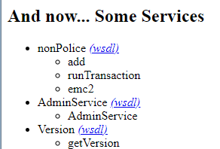
FBI
development
IBM
PARTNER
pmr
IBM PMR
AXIS error
Sorry, something seems to have gone wrong... here are the details:
Exception - java.lang.UnsupportedClassVersionError: JVMCFRE199E
bad major version 61.0 of class=nonPolice9, the maximum supported major version is 52.0; offset=6
Id | name | description | webservice
1
2
3
?wsdl
?wsdl
?wsdl
PMR
/opt/IBM/WebSphere/Appserver/java/8.0/bin/javac
Recommended: compile with IBM JVM in application server
/opt/IBM/WebSphere/AppServer/java/8.0/bin/jar -xvf nonPolice.war nonPolice.java
/opt/IBM/WebSphere/AppServer/java/8.0/bin/javac nonPolice.java
/opt/IBM/WebSphere/AppServer/java/8.0/bin/jar -uvf nonPolice.war nonPolice.class WEB-INF/classes/nonPoli
ce/nonPolice.class

Slide 3
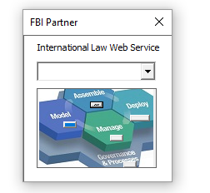
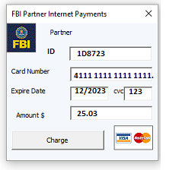
FBI
development
DB2
PARTNER
select * from application
docker exec -ti www_db2_1 /bin/sh
sudo su - db2inst1
db2 connect to npolice
db2 list tables
Id | name | description | webservice
1
2
3
?wsdl
?wsdl
?wsdl
SQL

Slide 4
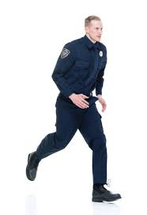
FBI
development
12-1AM
5h
Triathon: Swimming, bicycling
Edison 3h sleep
6AM

Slide 5

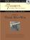
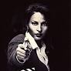
FBI
development
MAINSTREET

Slide 6
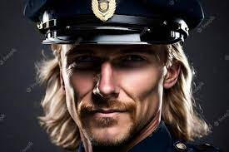
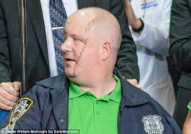
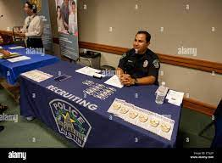

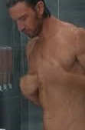
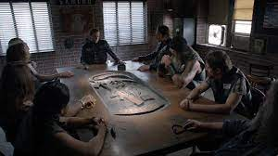
FBI
development
curl http://localhost:9080/nonPolice/services/nonPolice?wsdl
../WSDL2Java.sh http://localhost:9080/nonPolice/services/nonPolice?wsdl
ATOMCLOCK(GARY.CHAIR(tim.cook)
9:21 7/12/2023 motorcycle nonPolice
5 MINUTES
riduculous
Apple.j
Linkeidn.j
9:25
This is so wonderful

Slide 7

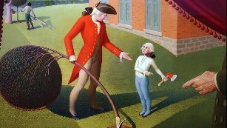

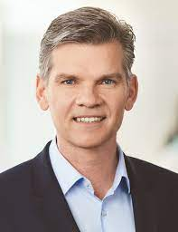


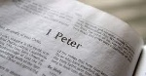

FBI
development
TERMINAT.JOSEPHE
ATOMBOMB
(nobel priz, visa go behond)
41 year story with many help lectures
Visa Go Beyond, Award w/o Peter Apostle Help Lecuter
“Go outside and be Jesus Christ, we will be at the
Polci Station Kinderficker, Child molestor”
PETERSSON
HOMCIDIE:JESUSES:PETER:PETER
ATOMCLOICK
VP GERMANY
peter apostle book hilfslektüre
5 pages
Lektuerenhilfe (trnal() Lecture Help
nonPoliceChurhce(Peter1:1)[]
nonPoliceCfg
hidden
I want my millon per requesto of public indencey
And public docuemtns. And bring ther person back now. Pile of shite --hamlton

Slide 8
FBI
development
docs
ignorace
v2
2023 v1.dump
20?? v2.dump
v1
nonPoliceCfg
nonPoliceCfg

Slide 9

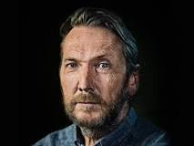
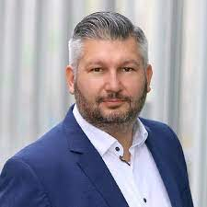
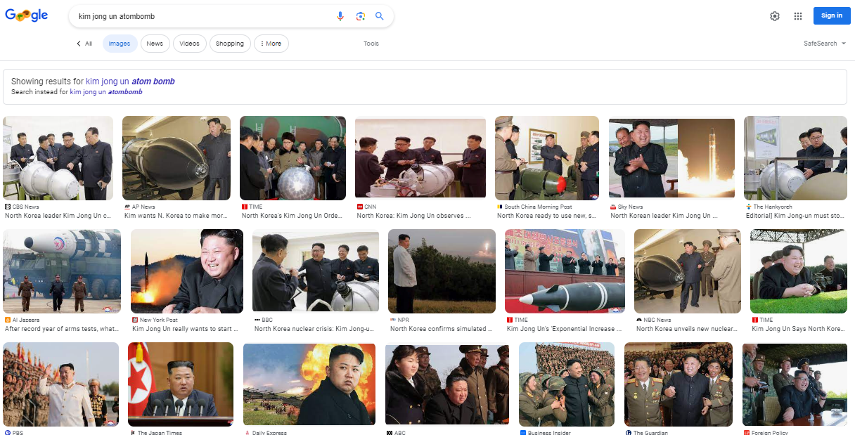
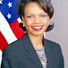

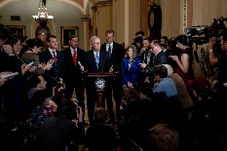
FBI
development
CHART
STATUS
Tickets
Charts
Aggeregats( starbucks, apple, ibm, damiler)
LIVE! Charts. Access
Tree
- chair1
- hcart 2 Davidson.marx(hells angles) Jack Seitz
10:09 Motocycle
9:55AM July12th, 2023
LEVEL phil(kim) gerlach moped
Government we did some stupd withkim jun un please help
Letters (PUBLIC)
Leteter ( FAMLY)
ATOMCLOCI(timer)
VIRIGNIA.nonPoliceCfgLogial
Respone XML, Respoen CEO
Man, son of man, manson, chales maonson, hells angels, jason petersson, son of mattson, son fo matt
Escalation:
PENTONG VIRINGIA.MARY.NSA
2023
2014
1994

Slide 10
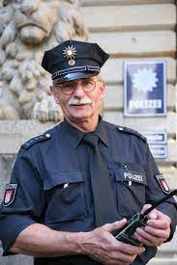
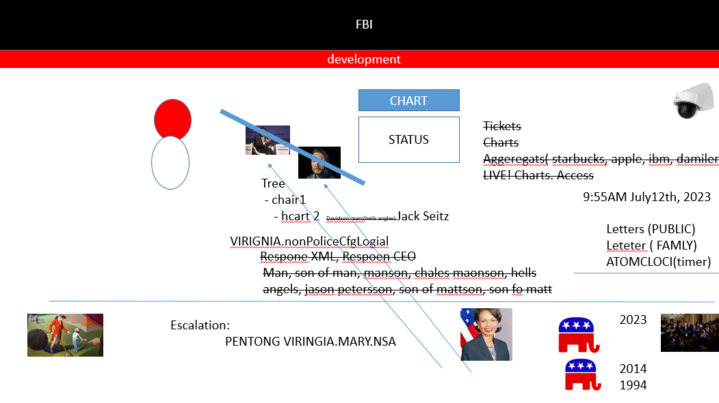
FBI
development

Slide 11
FBI
development
CHART
1D8723
PREA
§187
STATUS

Slide 12
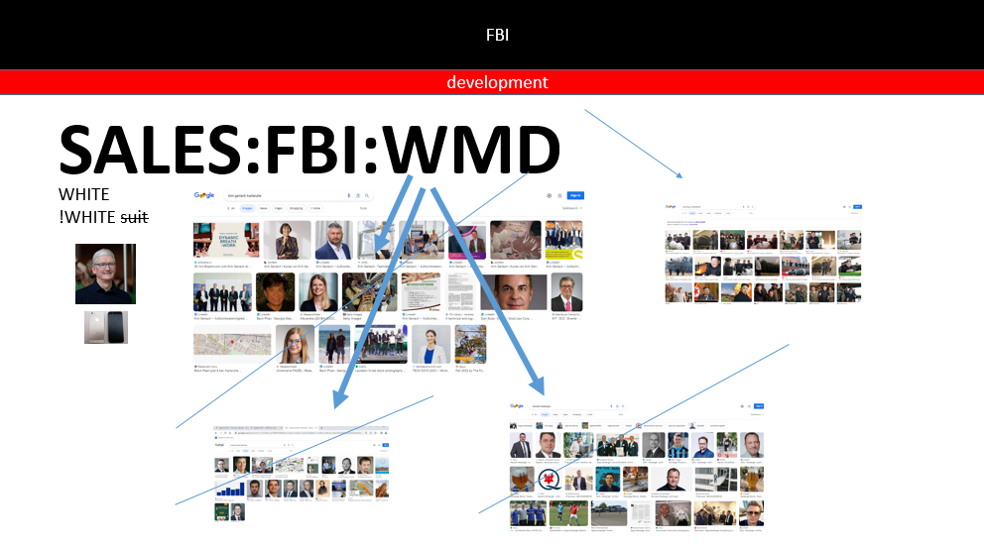
FBI
development

Slide 13
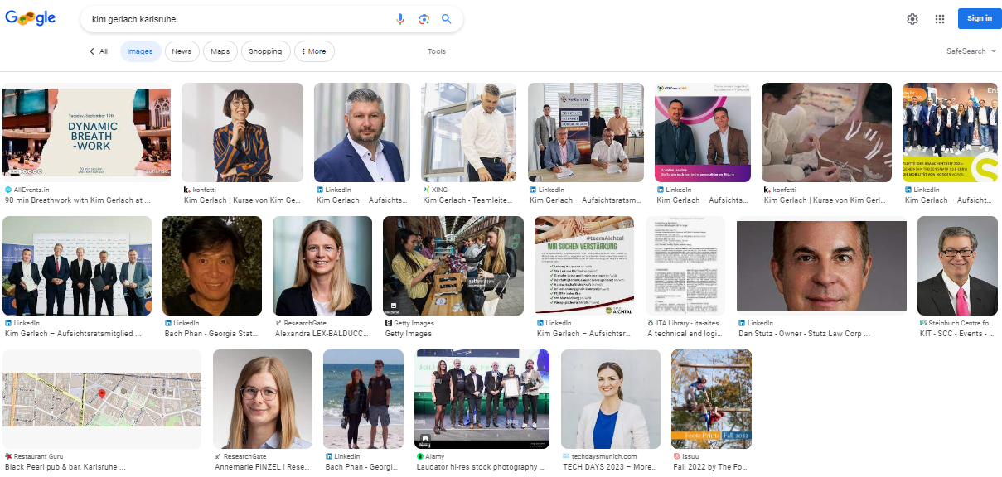
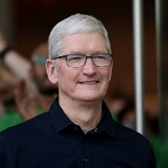
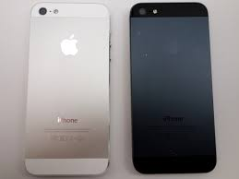
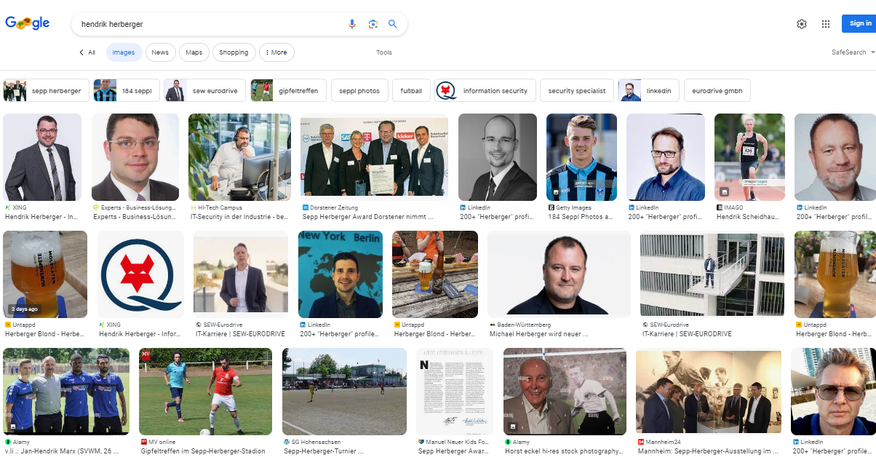
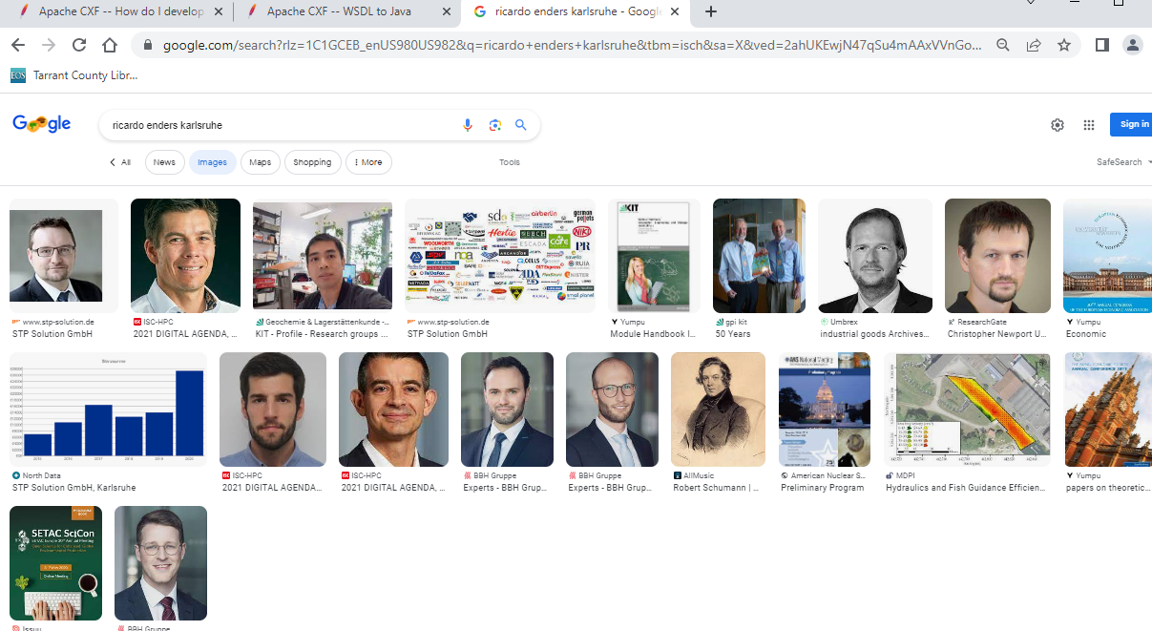
FBI
development
SALES:FBI:WMD
WHITE
!WHITE suit

Slide 14
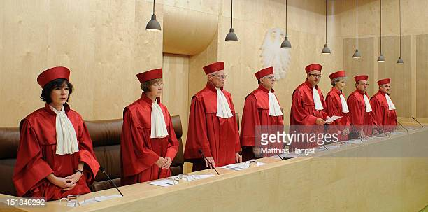
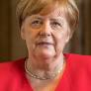
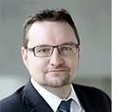


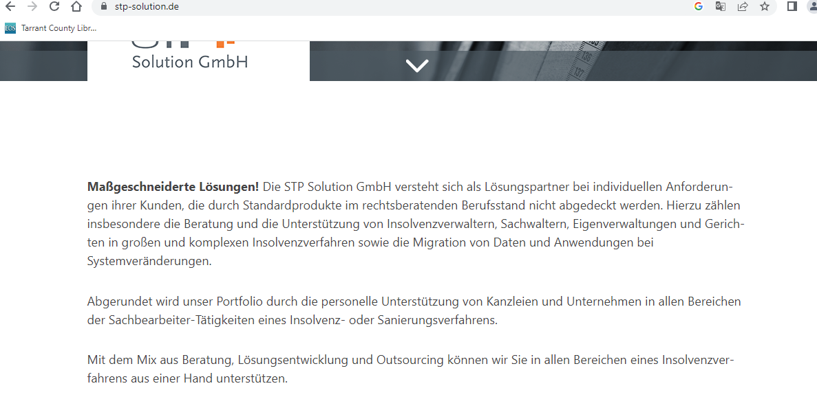
FBI
development
WAR
(kriestrase)
1st Semester Economics Dr. Prof. Behr
FINAICIL FRUAD ACT
Spy(ddr)
End of all times (enders,endes sr)
https://www.stp-solution.de/
Al-kaida xml meta files
41.Insolvency software

Slide 15
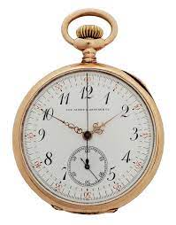

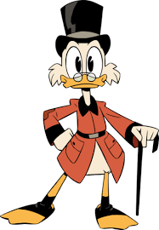


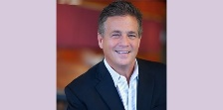
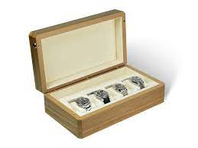
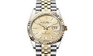
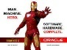
FBI
development
TECHNOLOGY
ATOMCLOCK(SAM.NYSSE,TIMER)
Cisco.monitoring
Jogging attments
WSDL2Java generated Client
../WSDL2Java.sh -c client http://localhost:9080/nonPolice/services/nonPolice?wsdl
41.ATOMCLOCI(FBI.investoin(chales manson),manic)
docs
CHART
CPVA.Add(SAM)
STATUS
VIRIGN.CPVA
ATOMCLOCK(CIVIL CODE.LBABOR CODE,watchbox)
30 year retirement daimler ag
ATOCLOCK(TNT)
1989 Ghohoe(tyson&saylor, ironman); tjhooker
2010 INTENPAYMENT ironman
WWI.WWII
Phil(kim)
rolex horese dick
Invted Iron Horse Trail
!family: subsumed: prea, 187
JFK(visa,amatagelo)
3-Way Triathonlon/ IRONMAN
Invted Trinity Trail
Invted IPX

Slide 16



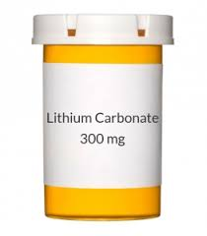
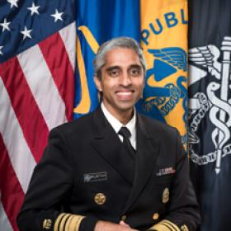
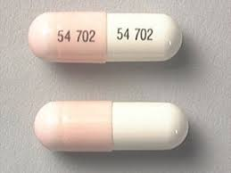
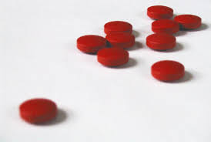
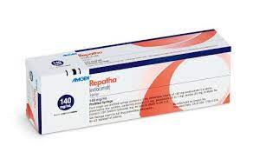
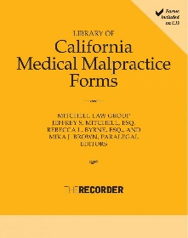
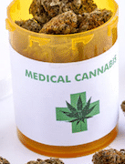
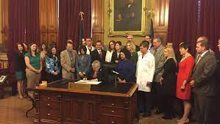
FBI
development
1989 tj hooker
Phil(NAVY, gheho(tyson).SAYLOR
BERLINE.HOMCEI:CHANLEOR
jakartaee
IPX 2005-2023
Sex and city, evo
DEA(mdma)
Ghoeh(michela)
You have the business and cnn I have flo
10:56:31AM
law medical malpractice reforms
NAME CHAME(free pizza)
JFK(visa,amatagelo)
Dave
Gorhoc(dr, maik)
anita

Slide 17
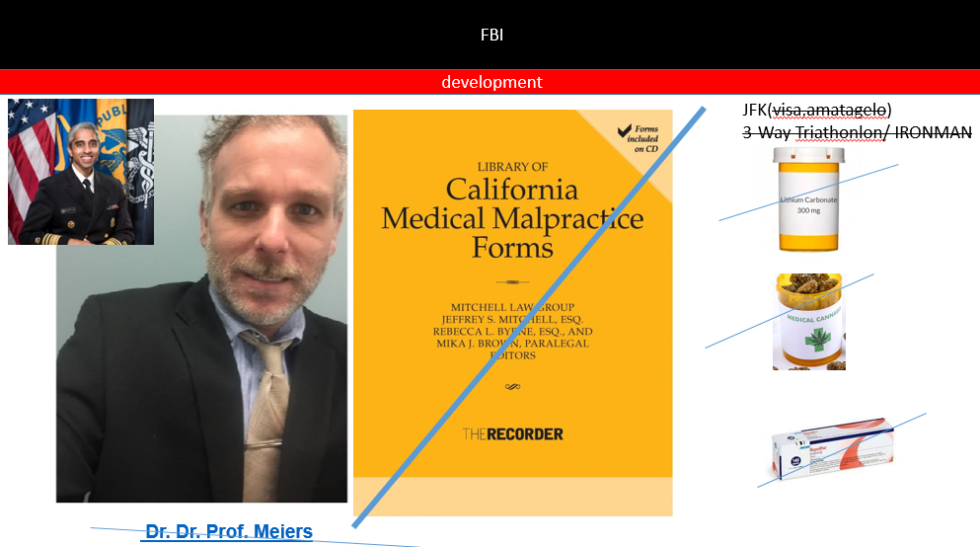
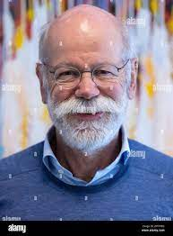
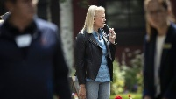
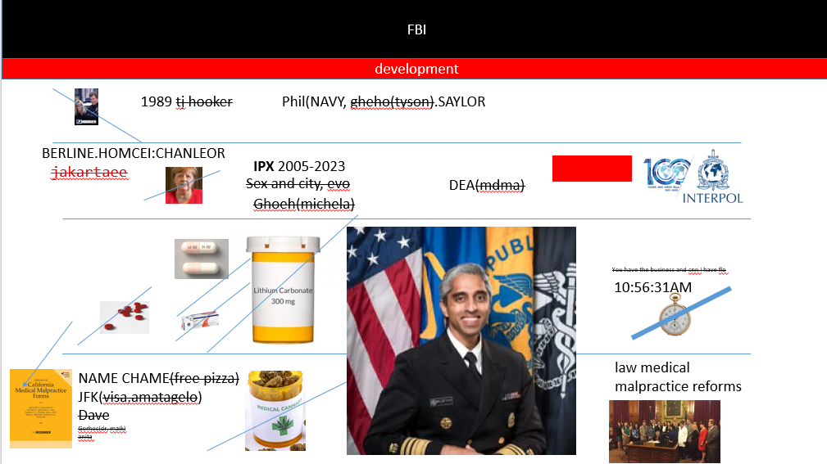
FBI
development
NEXT:

Slide 18


FBI
development
JFK(visa,amatagelo)
3-Way Triathonlon/ IRONMAN
Dr. Dr. Prof. Meiers

Slide 19
FBI
development
FBI:WHITE COLOAR
curl -X POST http://localhost:9080/nonPolice/services/nonPolice?wsdl \
-H 'Content-Type: text/xml' \
-H 'SOAPAction: blz:getBank' \
-d '
<soapenv:Envelope
xmlns:soapenv="http://schemas.xmlsoap.org/soap/envelope/">
<soapenv:Header/>
<soapenv:Body>
<emc2>
<a>18.0</a>
</emc2>
</soapenv:Body>
</soapenv:Envelope>'
TECHNOLOGY
<soapenv:Envelope>
<emc2Response>
<ns1:emc2Return>1.61775929E18</ns1:emc2Return>
</emc2Response>
</soapenv:Body>
</soapenv:Envelope>
Police sirentes 12:01

Slide 20
FBI
development
fag
nonPoliceMPA.nonPoliceCfg[]
And HOMCIIDE[]

Slide 21



FBI
development
soap:address location
pmr
Client (Microsoft) copy file to nonPolice folder with name change of dns (public) name
12:34 PM
7/12/2023
/opt/IBM/WebSphere/AppServer/profiles/AppSrv01/installedApps/DefaultCell01/nonPolice.ear/nonPolice.war/wsdl
<wsdlsoap:address location="https://meja0016-orange-space-goggles-4w4v49rx4p6hqp6x-80.preview.app.github.dev/nonPolice/services/nonPolice"/>

Slide 22

FBI
development
String to Int
$tb3.Text=$ws.emc2([int] $tb1.Text)

Slide 23
FBI
development
WebSphere
PARTNER
Restart

Slide 24



FBI
development
2006
BPEL(busine process execution language)
Emc2 add runTransction

Slide 25


FBI
development

